Slide 1




Can Whole Air Sampling be used as an Air Quality Compliance Tool?
Jack Biscupski, Computer Science and Engineering, University of Iowa
Professor: Don Blake Mentor: Chris Woods

Slide 2
What are HCFCs?
HCFC-22 HCFC-141b HCFC-142b
H
F C F
Cl
F
Cl C CH₃
Cl
F
Cl C CH₃
F
Common Name | Lifetime (year) | GWP (100 year) | ODP
HCFC-22 | 11.0 | 1790 | 0.055
HCFC-141b | 9.2 | 717 | 0.11
HCFC-142b | 17.2 | 2220 | 0.065
CFC-11 | 45 | 4750 | 1.0
CFC-12 | 100 | 10900 | 1.0
Barletta et. al 2013
Notes:
focused on HCFCs
intermediate compound replacing CFC stocks around world
structure similar to CFC except they have hydrogen
CFC11 & 12 have much longer lifetimes cuz no hydrogen
Also give up less reactive chlorine due to hydrogen
can see how chlorine affects compounds – point out 141b and 142b diffs
22 used for industrial refrig, 141b used as aerosol blowing agent, 142b as well but also small quantities as retrofit refrig

Slide 3
Policy
Montreal Protocol
Clean Air Act (CAA)
1993 HCFC phaseout
plan as part of
CAA regulations
Year to be Implemented | 2003 | 2010 | 2015 | 2020 | 2030
Percent Reduction | 35% | 75% | 90% | 99.5% | 100%
https://www.epa.gov/ods-phaseout/phaseout-class-ii-ozone-depleting-substances
Notes:
Policy is most important aspect of alleviating HCFC emissions
Montreal Protocol most effective policy for air regulation
Clean air act signed into law in 90s, reflects US’s obligations in Mon. Protocol
EPA used ‘worst first’ approach for determining which hcfcs to phaseout first (my 3)
Example of a shorthand phaseout plan developed by EPA
percent reduction can be quite hard to find and calculate, and subsequently enforcement of this phaseout, so
One of goals of project was to use our data to be able to better asses policy and phaseout goals

Slide 4
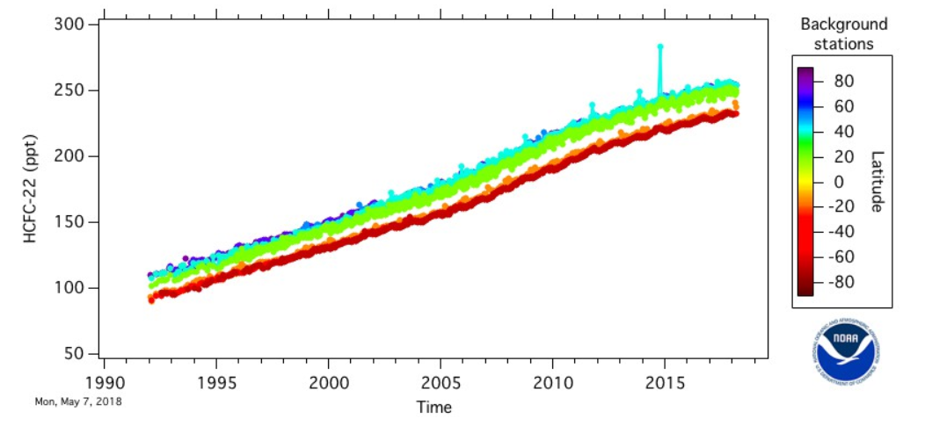
Global HCFC-22 Trend
ESRL/NOAA Global Monitoring Division data
Notes:
NOAA’s earth system research lab provides public w/ high quality data over chems that affect atmosphere
Measured at stations around globe, latitude indicated by color bar
Been steadily increasing since inception of HCFCs, not surprising
Interesting to note the discrepancy btwn north hem and south hem

Slide 5
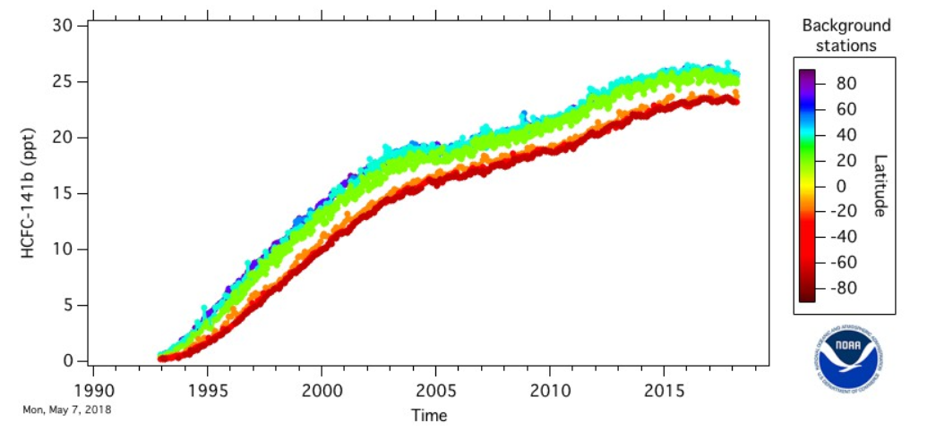
Global HCFC-141b Trend
ESRL/NOAA Global Monitoring Division data
Notes:
Starts to level off right around 2015, lining up well w/ 2015 goal of EPA’s phaseout plan
North/south hem discrepancy is here as well

Slide 6
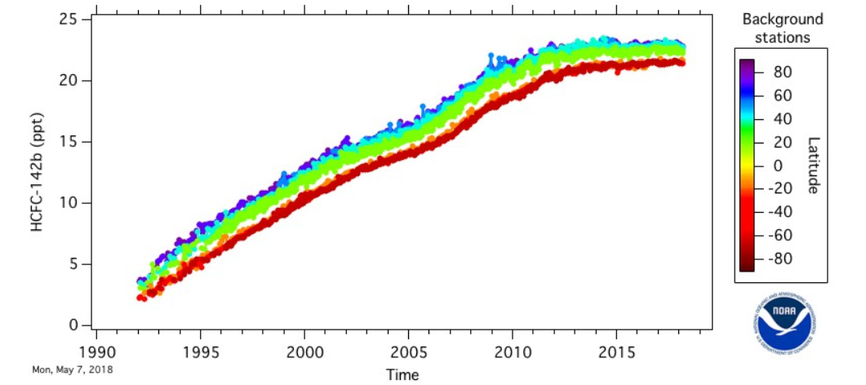
Global HCFC-142b Trend
ESRL/NOAA Global Monitoring Division data
Notes:
similar trajectory at tailend of graph to 141b
gap between hemispheres isn’t as big, meaning either north comparatively isn’t using as much 142b or south is catching up to north’s usage
moving on to how our group collected data

Slide 7

Methods – Whole Air Sampling
Snakes holding gas canisters for flight data
Benefit of collaborating with other groups and
their real-time data: Change our sampling plan!
Notes:
7 snakes on DC-8 plane
consist of 24 2 L gas canisters, hooked up to sampling port on outside of plane
Taking sample consists of manipulating inlet/outlet valves on snake as well as on can in timed intervals
Worked in teams to coordinate sampling w/ timing & writing down of metadata
sampling plan created by flight staff and scientists beforehand, but
cool benefit to being on plane w/ other research groups using their own sensors: can change sampling plan on fly
Carbon monoxide/smoke plume example

Slide 8


Methods – Data Analysis
http://logos.wikia.com/wiki/Google_Earth
https://anaconda.org/ijstokes/data-science-apps-with-anaconda/notebook
Notes:
Even though Excel isn’t up here, talk about how all of our data was merged into essentially an Excel sheet database, and this is how we did our preliminary analysis (looking for trends)

Slide 9
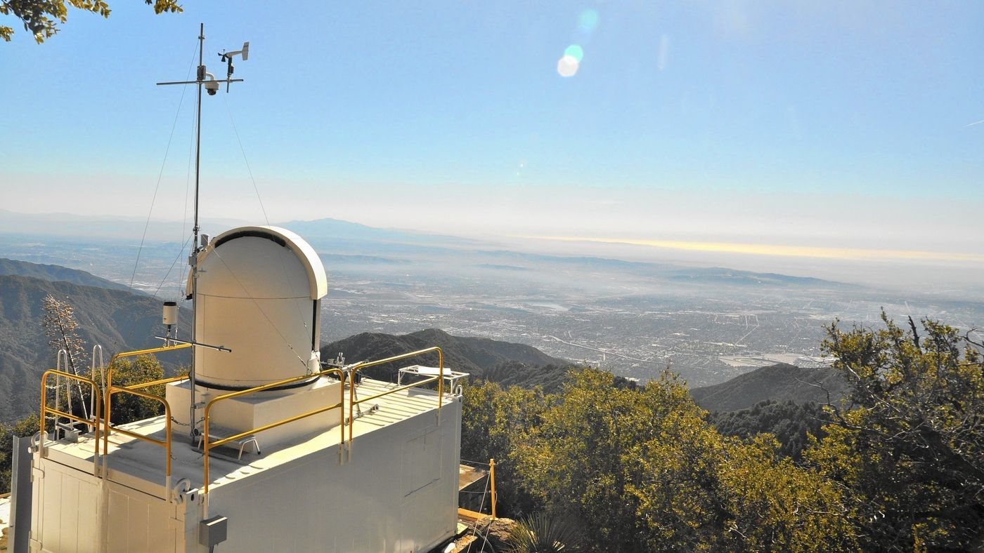
http://www.latimes.com/science/la-me-methane-emissions-20150114-story.html#
Notes:
Looked at not this years data first, but Mt Wilson data
pic of mount Wilson overlooking Pasadena/LA area

Slide 10
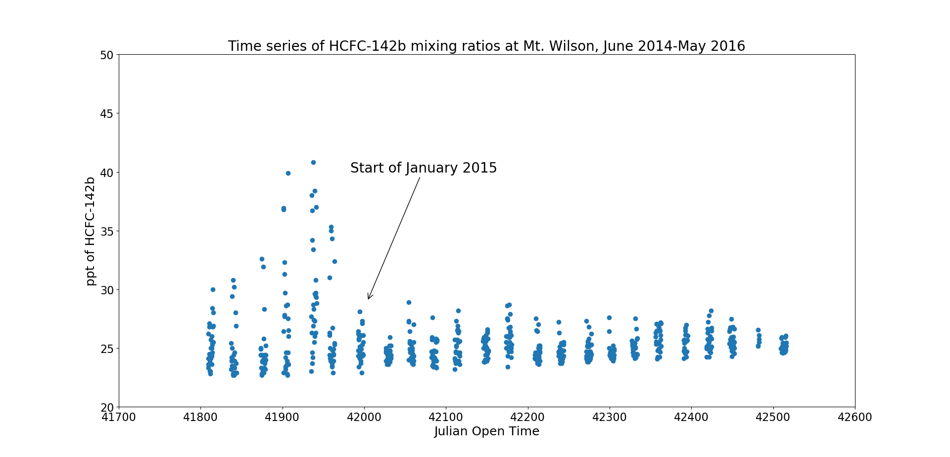
What does effective policy look like?
Notes:
Collected via auto samples WAS set up funded by California air resources board\
x axis time, y axis ppt of 142b
data is in clumps bcuz sampled for 1 week straight every month from June 2014-May 2016
Data is really exciting cuz it shows effective policy at work in the real world:
almost directly coincides with 2nd step of HCFC phaseout plan

Slide 11
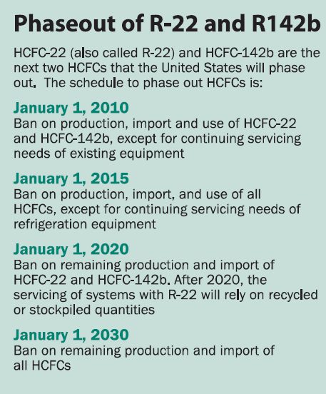
https://www.epa.gov/ozone-layer-protection
Notes:
subtle diff btwn 1st step and 2nd step
while policy was effective for 142b, shouldn’t expect same for 22
I can confirm this

Slide 12
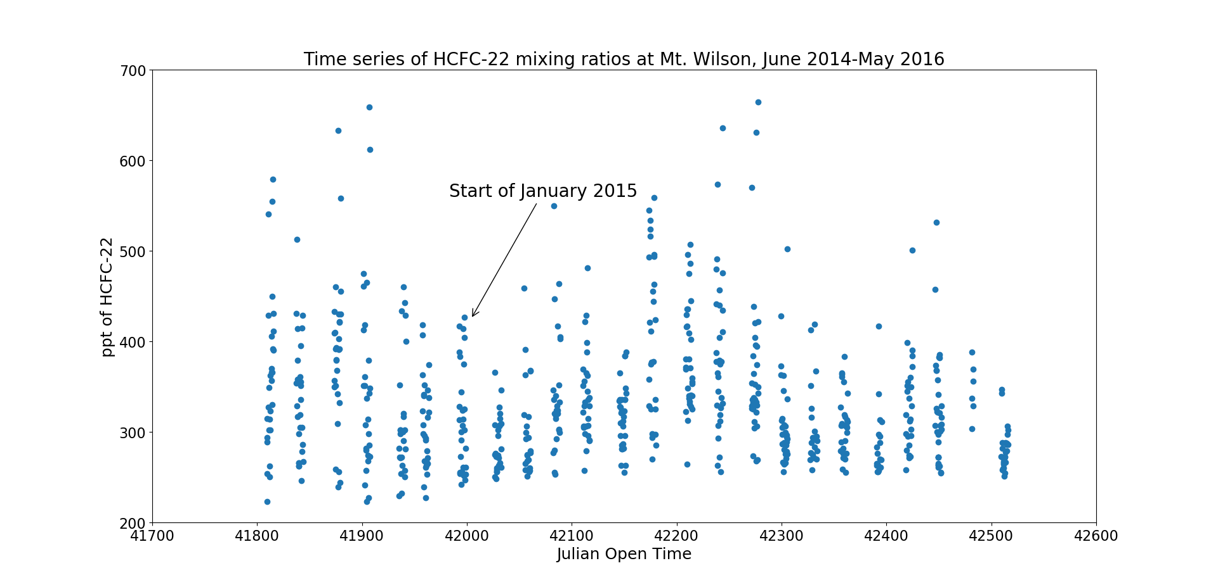
Notes:
due to 22 being used almost solely as refrig
looking at same graph as b4 but with 22, we can see policy rightfully didn’t do anything to alleviate levels of 22

Slide 13
Preliminary analysis of SARP 2018 data
Notes:
moved onto current year SARP data
plotted mixing ratio in ppt vs latitude for all 3 compounds
high ppt nodes at 33.5 and 35.8
mt Wilson data corroborates this cuz hcfc 22 levels were not affected by phase out plan

Slide 14
Notes:
spikes in ppt levels for 141b at around the same latitudes
however, there is more variability in data here

Slide 15
Notes:
142b didn’t show latitudinal spikes like other 2 compounds, which is good
mt Wilson data showed us that 142b levels dropped off at start of 2015
This data includes urban, ag, mountainous, salton sea, etc. Well mixed sample size – policy isn’t
wanted to know where exactly these spikes in emissions were coming from, so I mapped data onto basemap of so cal

Slide 16
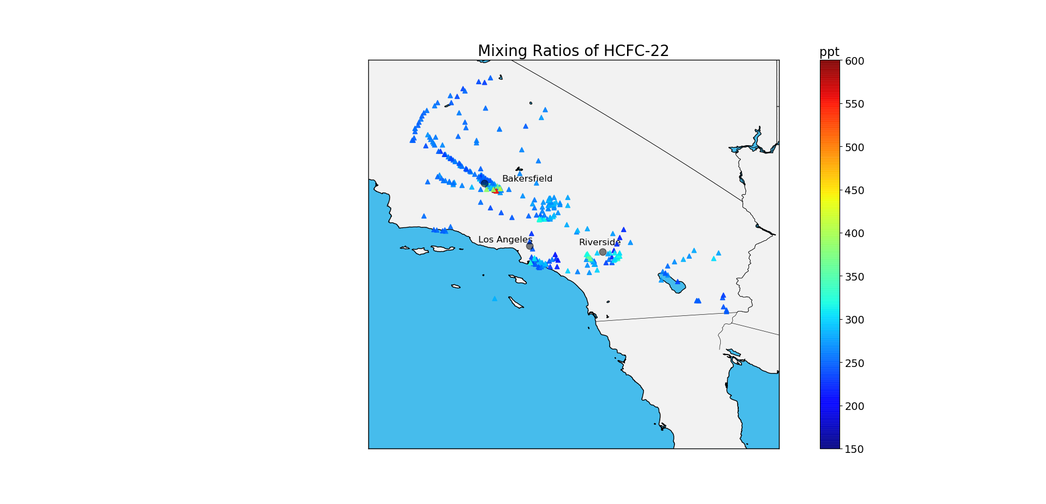
Background levels: 240-250 ppt
15
Notes:
colorbar indicates level of HCFC-22
referencing top half of NOAA global data, cuz northern hemis, we see highly elevated vals near Bakersfield
Not surprising, Bakersfield is hub for industrial processes
Bakersfield would def be an area to look into

Slide 17

Background levels: 22-25 ppt
16
Notes:
more pronounced areas of elevated mixing ratios to east/west of riverside, and south of LA
also trail of elevated values to west of Bakersfield
We saw how effective policy did wonders at Mt. Wilson for emission alleviation – could this analysis be used in situations for the aforementioned problem areas?

Slide 18
Enforcement
EPA allows for input from other federal, state, and tribal regulatory agencies
A framework for a compliance order pipeline - CAA Stationary Source Compliance Monitoring Strategy (CMS)
Funding is available – state and tribal assistance grants budgeted for State and Local Air Quality Management
Notes:
important for more locally scoped governmental agencies to have say in enforcement of regulations cuz close proximity to businesses/their pollution
how CMS works – proposals by smaller agencies are rated for sign env benefits, and whichever proposals have most sign benefits, EPA will consider more heavily
grant category for State and Local Air Quality Management

Slide 19
Conclusion – A Powerful Compliance Tool
This sampling & analysis plan could be utilized by smaller agencies to target problem areas (LA, Bakersfield, etc.)
Possible integration into the Clean Air Act’s Stationary Source CMS
Assess phaseout plans more accurately, and craft better policy in the future
Notes:
believe this sampling/analysis plan could be used as tool to target problem areas
if streamlined into CMS, national consistency would go a long way for making this accessible to smaller places
Standardize sampling plans such as using airborne data or using auto samplers like ones on mt. wilson
asses phaseout plans more accurately, craft better policy in future

Slide 20

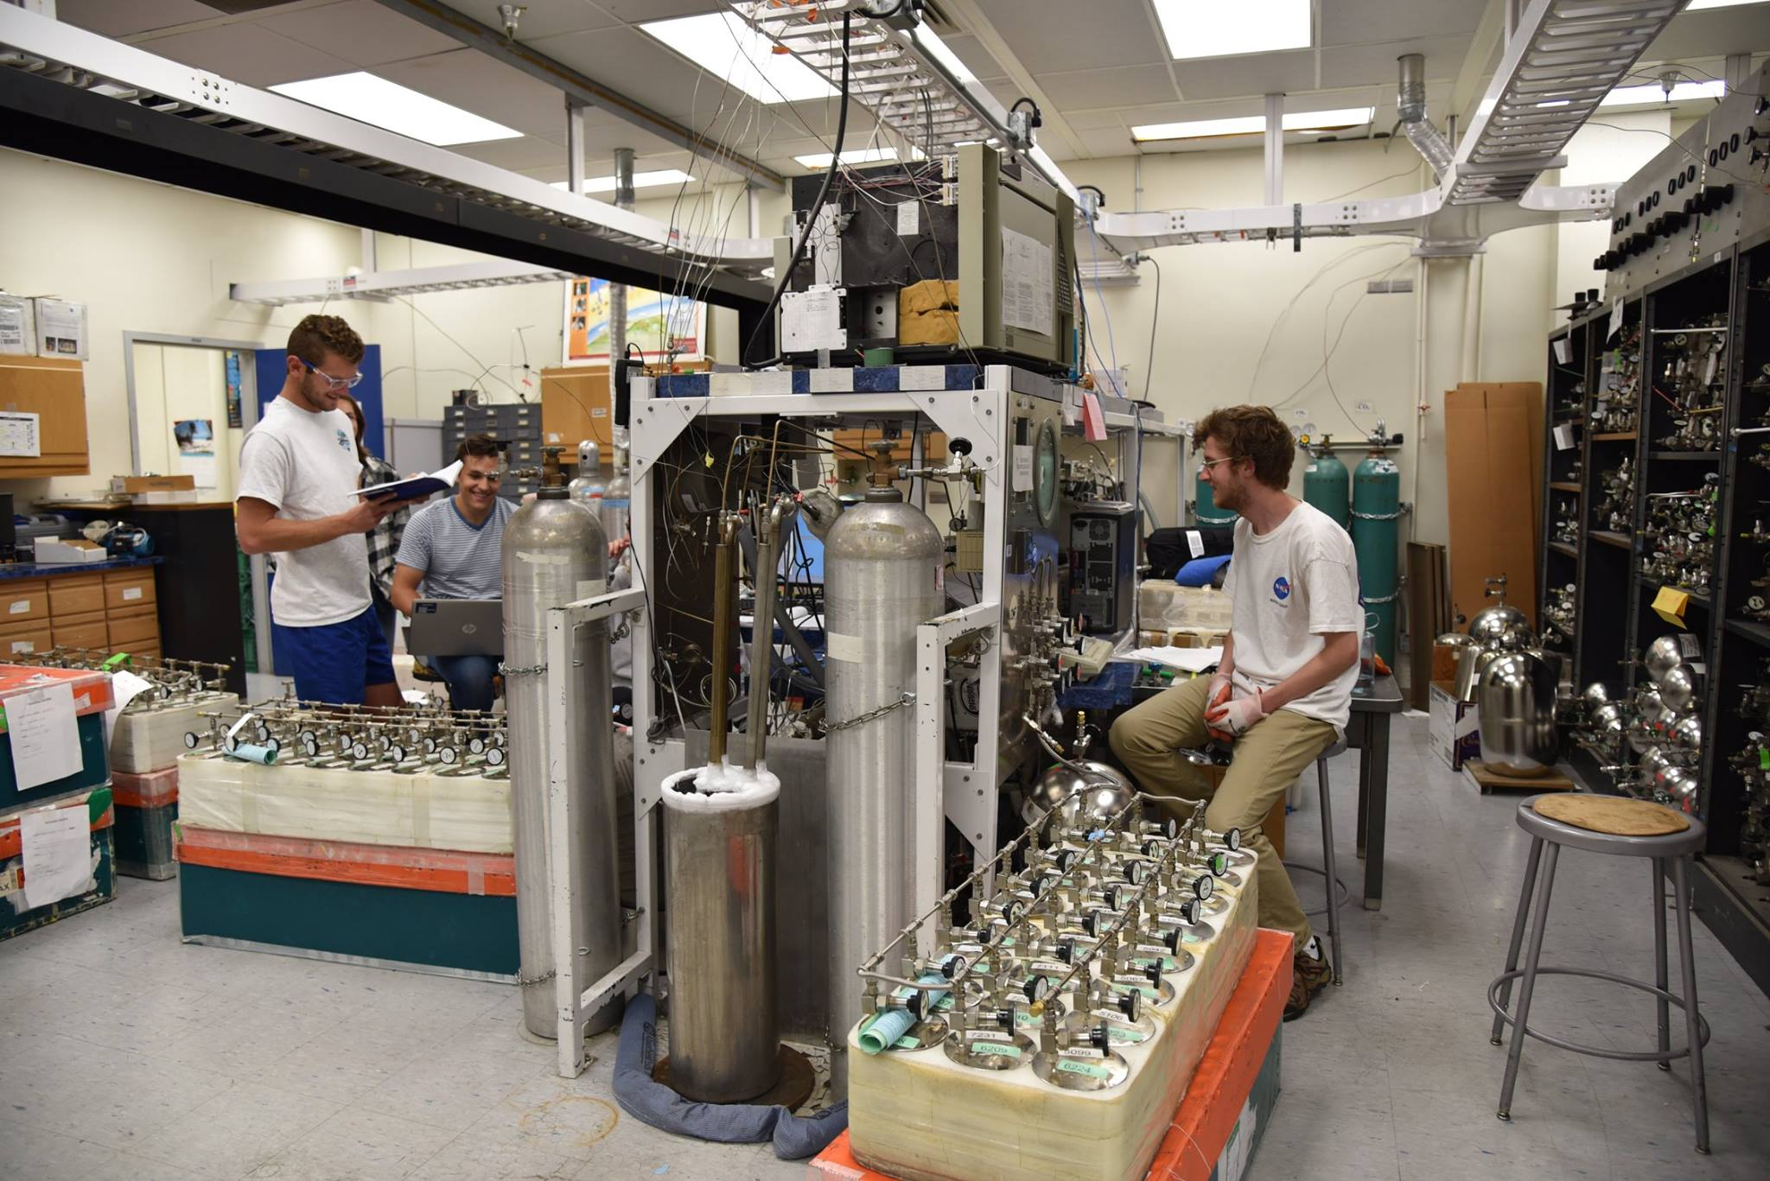
Acknowledgements
Faculty PI: Dr. Don Blake
Faculty Mentor: Chris Woods
Program Director: Dr. Emily Schaller
Rowland/Blake Lab Members:
Simone, Gloria, Brent, Fred, Alicia, Brenna, Alex
WAS group members

Slide 21
Works Cited
“Clean Air Act (CAA) Compliance Monitoring.” EPA, Environmental Protection Agency, 8 Feb. 2017, www.epa.gov/compliance/clean-air-act-caa-compliance-monitoring.
“FY 2019 Justification of Appropriation Estimates for the Committee on Appropriations: State and Tribal Assistance Grants.” Environmental Protection Agency, Feb. 2018.
Hindin, David. “Clean Air Act Stationary Source Compliance Monitoring Strategy .” Environmental Protection Agency, 4 Oct. 2016.
“Phaseout of Class II Ozone-Depleting Substances.” EPA, Environmental Protection Agency, 9 May 2018, www.epa.gov/ods-phaseout/phaseout-class-ii-ozone-depleting-substances.
“Protection of Stratospheric Ozone: Adjustments to the Allowance System for Controlling HCFC Production, Import and Export, 2015–2019.” Environmental Protection Agency, 2014.
Team, ESRL Web. “ESRL Global Monitoring Division - Halocarbons and Other Atmospheric Trace Species.” NOAA Earth System Research Laboratory, 1 Oct. 2005, www.esrl.noaa.gov/gmd/hats/about/hcfc.html.

Slide 22




Questions?

